Slide 1
Introduction to
Cybersecurity
David J. Malan
malan@harvard.edu

Slide 2
Souvenir Photo

Slide 3
Introduction to
Cybersecurity
David J. Malan
malan@harvard.edu
Notes:
Alright, this is CS50's introduction to cybersecurity, my name is David Malan and this week let's focus on securing software, whether software you use as a user or software you write as a programmer

Slide 4
Securing Software

Slide 5
Phishing
Notes:
recall lecture0…

Slide 6
<!DOCTYPE html>
<html>
…
<body>
…
</body>
</html>

Slide 7
<p>...</p>

Slide 8
<script>...</script>

Slide 9
<a>Harvard</a>

Slide 10
<a href="…">Harvard</a>

Slide 11
<a href="https://harvard.edu">Harvard</a>

Slide 12
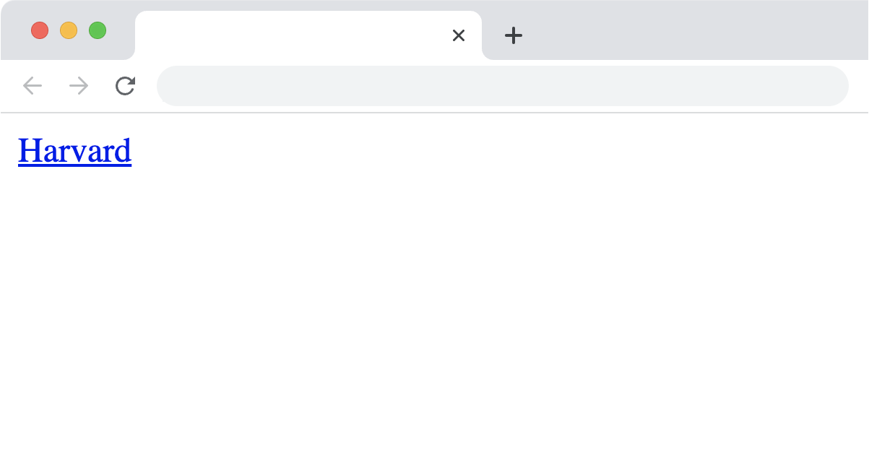

Slide 13
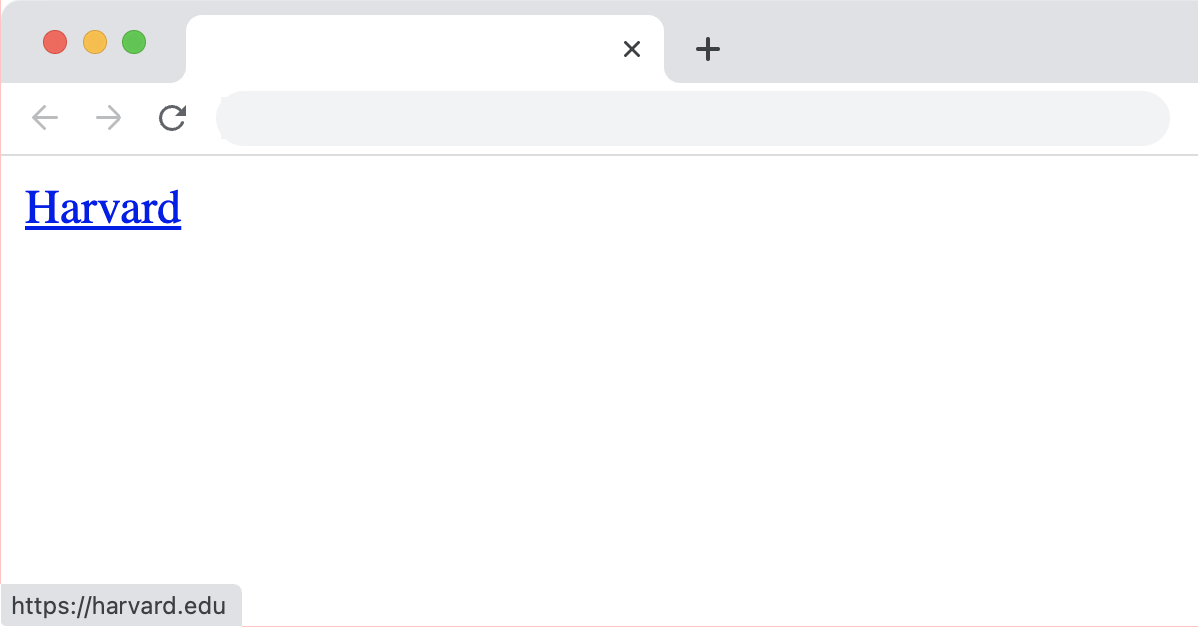

Slide 14
<a href="https://harvard.edu">Harvard</a>

Slide 15
<a href="https://harvard.edu">harvard.edu</a>

Slide 16
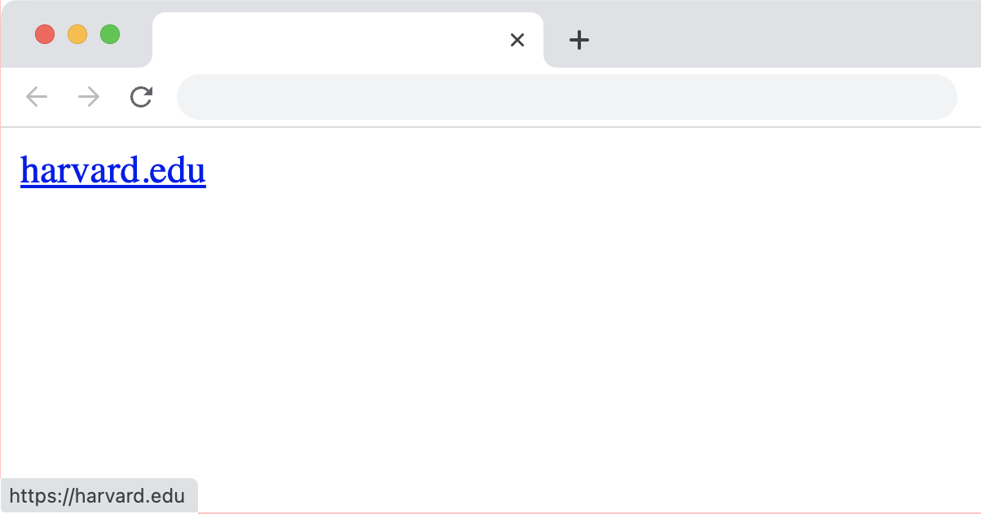

Slide 17
<a href="https://harvard.edu">harvard.edu</a>

Slide 18
<a href="https://harvard.edu">https://harvard.edu</a>

Slide 19
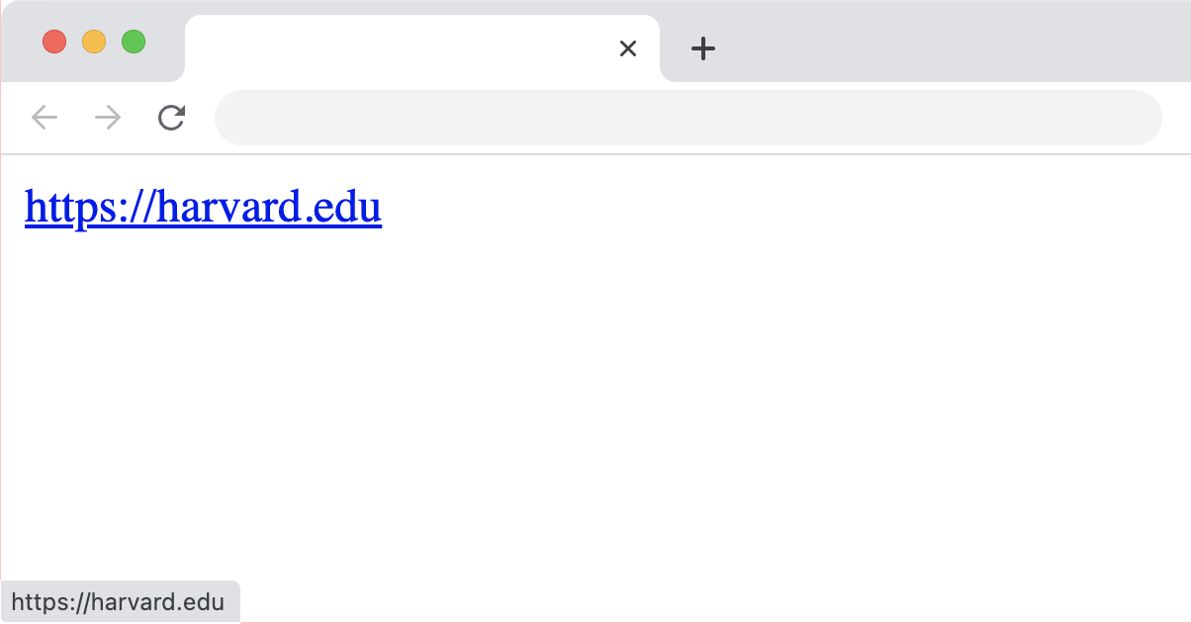

Slide 20
<a href="https://harvard.edu">https://harvard.edu</a>

Slide 21
<a href="https://yale.edu">https://harvard.edu</a>

Slide 22
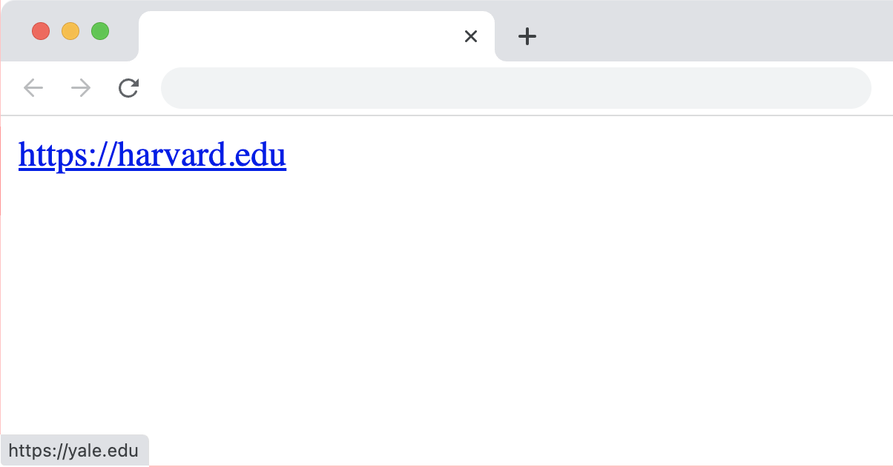

Slide 23
Code Injection
Notes:
https://owasp.org/Top10/A03_2021-Injection/

Slide 24
Cross-Site Scripting
(XSS)

Slide 25
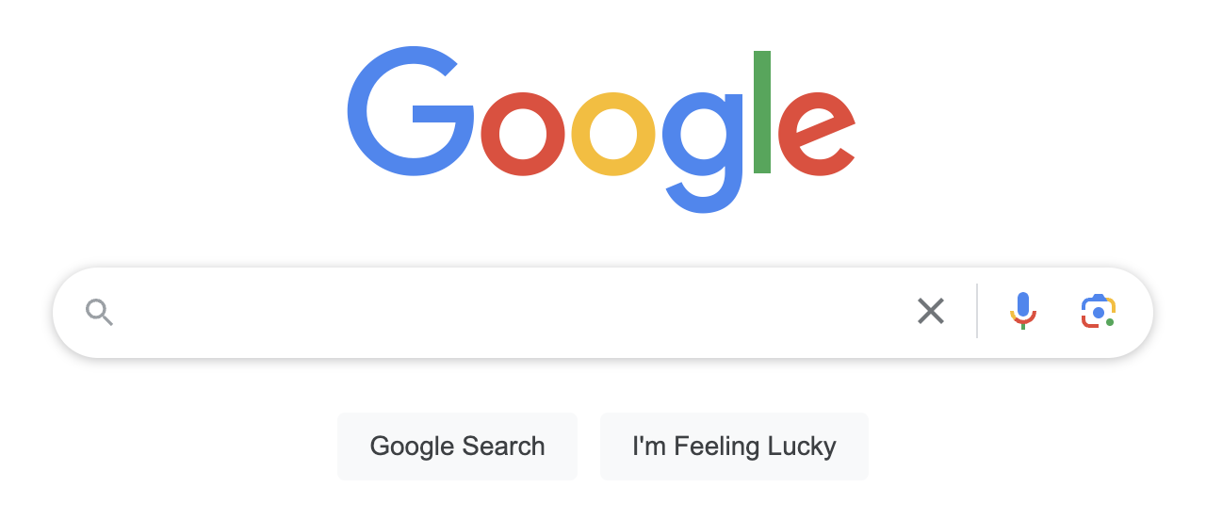

Slide 26
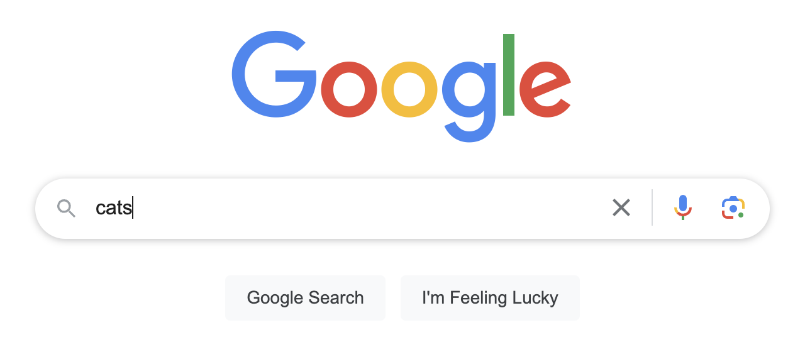

Slide 27
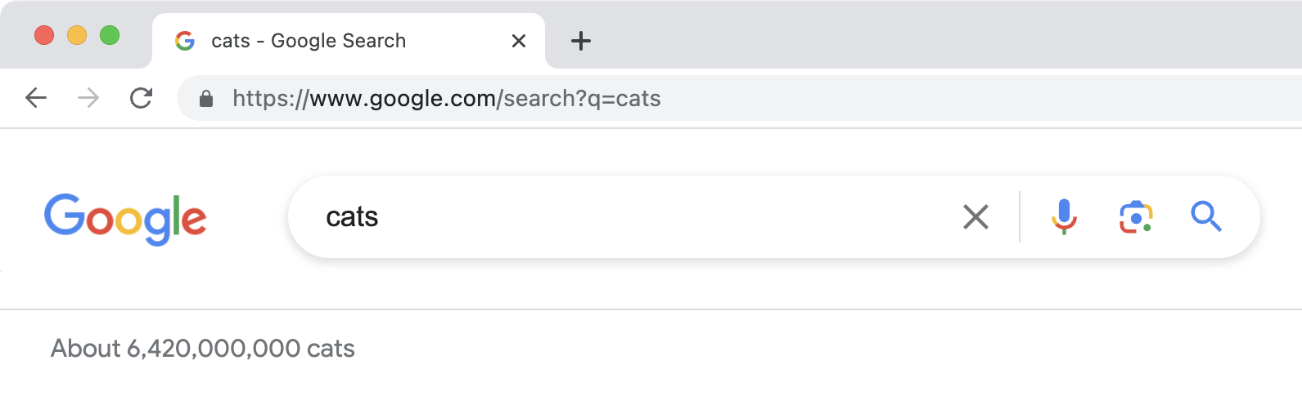

Slide 28
<p>About 6,420,000,000 cats</p>

Slide 30
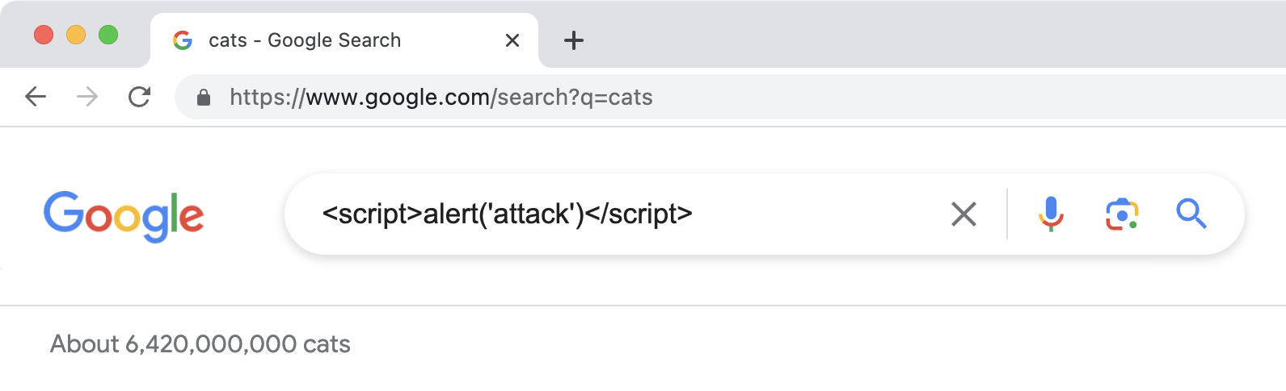

Slide 31
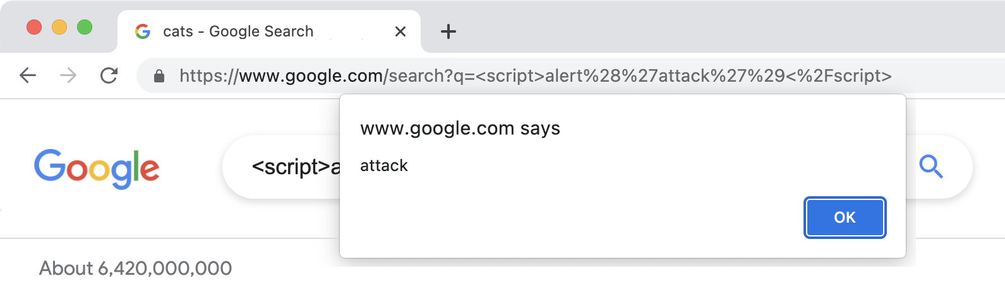

Slide 32
<p>About 6,420,000,000 cats</p>

Slide 33
<p>About 6,420,000,000 <script>alert('attack')</script></p>

Slide 34
<p>About 6,420,000,000 <script>alert('attack')</script></p>

Slide 36
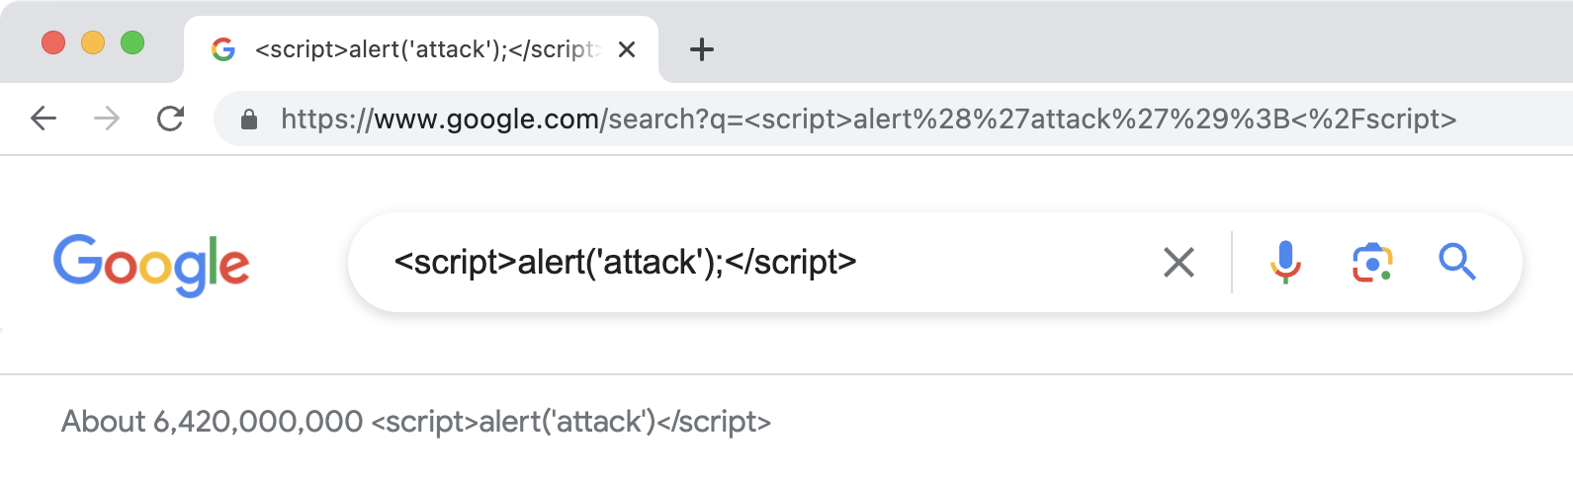

Slide 37
Reflected

Slide 38
<a href="…">…</a>

Slide 40
<a href="…">…</a>

Slide 41
<a href="https://www.google.com/search?q=cats">cats</a>

Slide 42
<a href="https://www.google.com/search?q=cats">cats</a>

Slide 43
<a href="https://www.google.com/search?q=cats">cats</a>

Slide 44
<a href="https://www.google.com/search?q=%3Cscript%3Ealert%28%27attack%27%29%3C%2Fscript%3E">cats</a>

Slide 45
<a href="https://www.google.com/search?q=%3Cscript%3Ealert%28%27attack%27%29%3C%2Fscript%3E">cats</a>

Slide 46
<a href="https://www.google.com/search?q=%3Cscript%3Ealert%28%27attack%27%29%3C%2Fscript%3E">cats</a>

Slide 47
<script>alert('attack')</script>

Slide 48
<script>alert(document.cookie)</script>

Slide 49
Stored

Slide 50
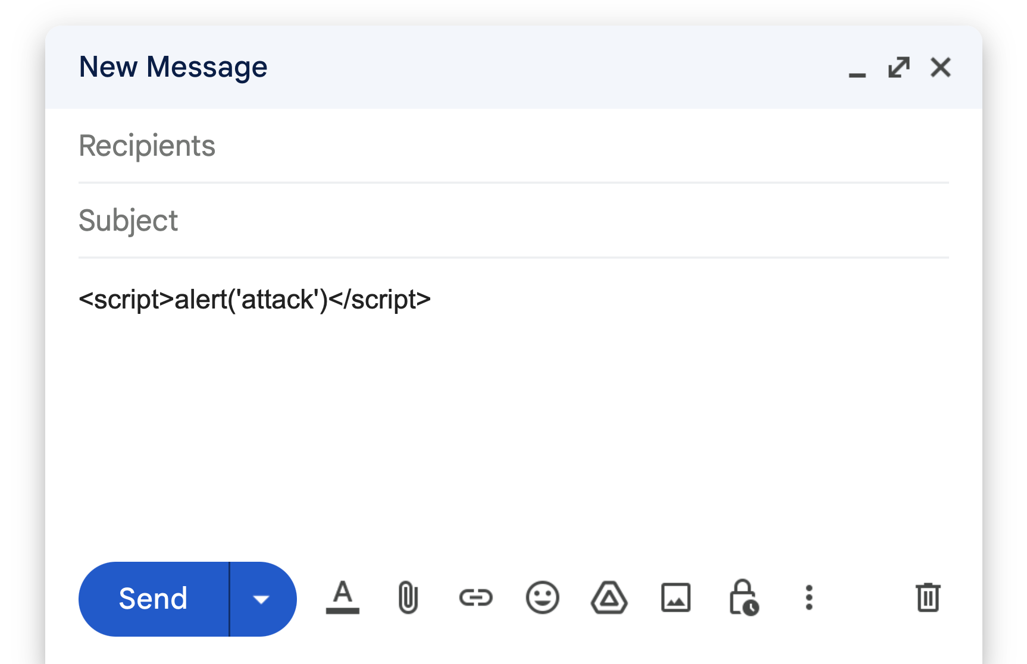

Slide 51
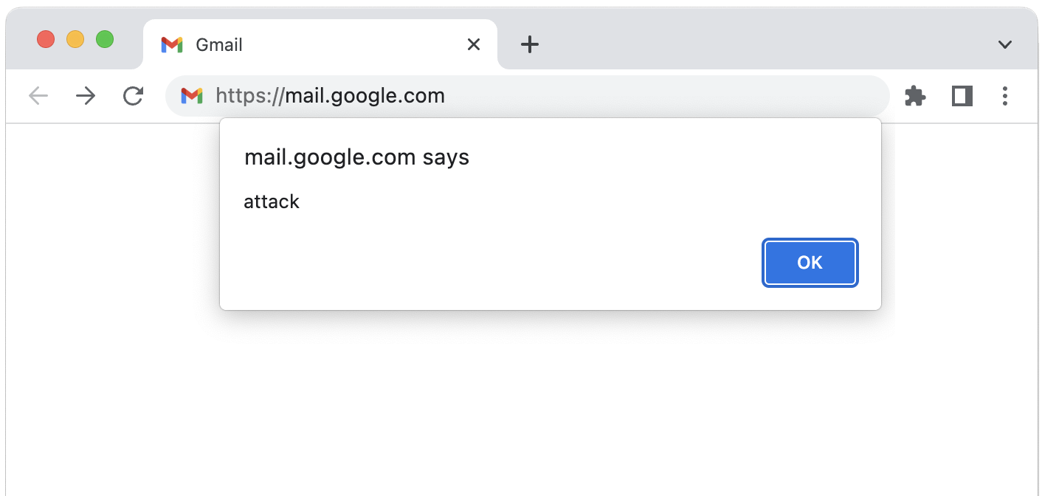

Slide 52
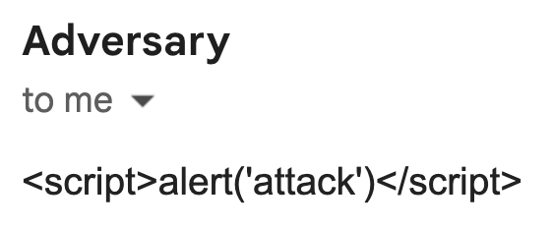

Slide 53
Character Escapes

Slide 54
<p>About 6,420,000,000 <script>alert('attack')</script></p>

Slide 55
<p>About 6,420,000,000 &lt;script&gt;alert('attack')&lt;/script&gt;</p>
Notes:
https://www.w3.org/International/questions/qa-escapes#use

Slide 56
<p>About 6,420,000,000 &lt;script&gt;alert('attack')&lt;/script&gt;</p>
Notes:
https://www.w3.org/International/questions/qa-escapes#use

Slide 57
&lt; (<)
&gt; (>)
&amp; (&)
&quot; (")
&apos; (')
…

Slide 58
Content-Security-Policy: script-src https://example.com/
Notes:
https://developer.mozilla.org/en-US/docs/Web/HTTP/Headers/Content-Security-Policy/script-src

Slide 59
<script src="…"></script>

Slide 60
Content-Security-Policy: style-src https://example.com/
Notes:
https://developer.mozilla.org/en-US/docs/Web/HTTP/Headers/Content-Security-Policy/style-src

Slide 61
<link href="…" rel="stylesheet">

Slide 62
SQL Injection

Slide 63
SELECT * FROM users
WHERE username = '{username}'

Slide 64
SELECT * FROM users
WHERE username = '{username}'

Slide 65
malan

Slide 66
malan'; DELETE FROM users; –-

Slide 67
SELECT * FROM users
WHERE username = '{username}'

Slide 68
SELECT * FROM users
WHERE username = 'malan'; DELETE FROM users; --'

Slide 69
SELECT * FROM users
WHERE username = 'malan';
DELETE FROM users;

Slide 70
SELECT * FROM users
WHERE username = '{username}' AND password = '{password}'

Slide 71
SELECT * FROM users
WHERE username = '{username}' AND password = '{password}'

Slide 72
malan

Slide 73
' OR '1'='1

Slide 74
SELECT * FROM users
WHERE username = 'malan' AND password = '' OR '1'='1'

Slide 75
SELECT * FROM users
WHERE username = 'malan' AND password = ''
OR '1'='1'

Slide 76
SELECT * FROM users
WHERE (username = 'malan' AND password = '')
OR '1'='1'

Slide 77
SELECT * FROM users
WHERE '1'='1'

Slide 78
Prepared Statements

Slide 79
'

Slide 80
''

Slide 81
SELECT * FROM users
WHERE username = '{username}'

Slide 82
SELECT * FROM users
WHERE username = ?

Slide 83
SELECT * FROM users
WHERE username = 'malan''; DELETE FROM users; --'

Slide 84
SELECT * FROM users
WHERE username = '{username}' AND password = '{password}'

Slide 85
SELECT * FROM users
WHERE username = ? AND password = ?

Slide 86
SELECT * FROM users
WHERE username = 'malan' AND password = ''' OR ''1''=''1'

Slide 87
Command Injection

Slide 88
system

Slide 89
eval

Slide 90
Developer Tools

Slide 91
<input disabled type="checkbox">

Slide 92
<input disabled type="checkbox">

Slide 93
<input type="checkbox">

Slide 94
Client-Side Validation

Slide 95
<input required type="text">

Slide 96
<input required type="text">

Slide 97
<input type="text">

Slide 98
Server-Side Validation

Slide 99
Cross-Site Request Forgery
(CSRF)

Slide 100
GET

Slide 101
<a href="https://www.amazon.com/dp/B07XLQ2FSK">Buy Now</a>

Slide 102
<a href="https://www.amazon.com/dp/B07XLQ2FSK">Buy Now</a>

Slide 103
<img src="https://www.amazon.com/dp/B07XLQ2FSK">

Slide 104
POST

Slide 105
<form action="https://www.amazon.com/" method="post">
<input name="dp" type="hidden" value="B07XLQ2FSK">
<button type="submit">Buy Now</button>
</form>

Slide 106
<form action="https://www.amazon.com/" method="post">
<input name="dp" type="hidden" value="B07XLQ2FSK">
<button type="submit">Buy Now</button>
</form>

Slide 107
<form action="https://www.amazon.com/" method="post">
<input name="dp" type="hidden" value="B07XLQ2FSK">
<button type="submit">Buy Now</button>
</form>

Slide 108
<form action="https://www.amazon.com/" method="post">
<input name="dp" type="hidden" value="B07XLQ2FSK">
<button type="submit">Buy Now</button>
</form>
<script>
document.forms[0].submit();
</script>

Slide 109
<form action="https://www.amazon.com/" method="post">
<input name="dp" type="hidden" value="B07XLQ2FSK">
<button type="submit">Buy Now</button>
</form>
<script>
document.forms[0].submit();
</script>

Slide 110
<form action="https://www.amazon.com/" method="post">
<input name="dp" type="hidden" value="B07XLQ2FSK">
<button type="submit">Buy Now</button>
</form>

Slide 111
<form action="https://www.amazon.com/" method="post">
<input name="csrf_token" type="hidden" value="1234abcd">
<input name="dp" type="hidden" value="B07XLQ2FSK">
<button type="submit">Buy Now</button>
</form>

Slide 112
<form action="https://www.amazon.com/" method="post">
<input name="csrf_token" type="hidden" value="1234abcd">
<input name="dp" type="hidden" value="B07XLQ2FSK">
<button type="submit">Buy Now</button>
</form>

Slide 113
POST / HTTP/3
Host: amazon.com
X-CSRFToken: 1234abcd

Slide 114
Open Worldwide Application Security Project (OWASP)

Slide 115
break

Slide 116
Arbitrary Code Execution
(ACE)

Slide 117
Remote Code Execution
(RCE)

Slide 118
Buffer Overflow

Slide 119
machine code
↑
stack

Slide 120
machine code

Slide 121
machine code
return address

Slide 122
machine code
"go to machine code"

Slide 123
machine code
cats
"go to machine code"

Slide 124
machine code
"go to machine code"

Slide 125
machine code

Slide 126
machine code
return address

Slide 127
machine code
"go to machine code"

Slide 128
machine code
attack code
"go to machine code"

Slide 129
machine code
attack code
…

Slide 130
machine code
attack code
"go to attack code"

Slide 131
Stack Overflow

Slide 132
machine code
↑
stack

Slide 133
Cracking

Slide 134
Reverse Engineering

Slide 135
Malware Analysis
Notes:
reverse engineering isn't all bad…

Slide 136
Open-Source Software

Slide 137
Closed-Source Software

Slide 138
App Stores

Slide 139
software →
→ hash

Slide 140
private key →
hash →
→ signature

Slide 141
Package Managers

Slide 142
Operating Systems
Notes:
root account, whole filesystem; macos prompts to access dirs

Slide 143
Bug Bounty

Slide 144
Common Vulnerabilities and Exposures (CVE)
Notes:
"The mission of the CVE® Program is to identify, define, and catalog publicly disclosed cybersecurity vulnerabilities."
https://cve.mitre.org/

Slide 145
National Vulnerability Database (NVD)

Slide 146
Common Vulnerability Scoring System (CVSS)

Slide 147
Exploit Prediction
Scoring System (EPSS)

Slide 148
Known Exploited
Vulnerabilities Catalog (KEV)

Slide 149
Introduction to
Cybersecurity
David J. Malan
malan@harvard.edu

